Slide 1






Foundations of
Quantum Information Science (QIS 101)
Dave Biersach
Brookhaven National Laboratory
dbiersach@bnl.gov
Session 15
Vector Algebra

Slide 2
Session 15 – Goals
Understand 3D axes in matplotlib
Plot Archimedes' Spiral in 3D using cylindrical coordinates
Understand 3D vertices and facets in matplotlib
Plot a 3D wireframe monolith using Cartesian coordinates
Plot a 3D pyramid that conforms with the Golden Ratio
Relate poloidal and toroidal angles in spherical coordinates
Use Numpy to generate the outer product of two vectors
Plot a 3D sphere using only vertices (a scatter plot)
Plot a 3D wireframe and facets of a sphere and torus
Plot the 3D surface plot of a multivariable function

Slide 3
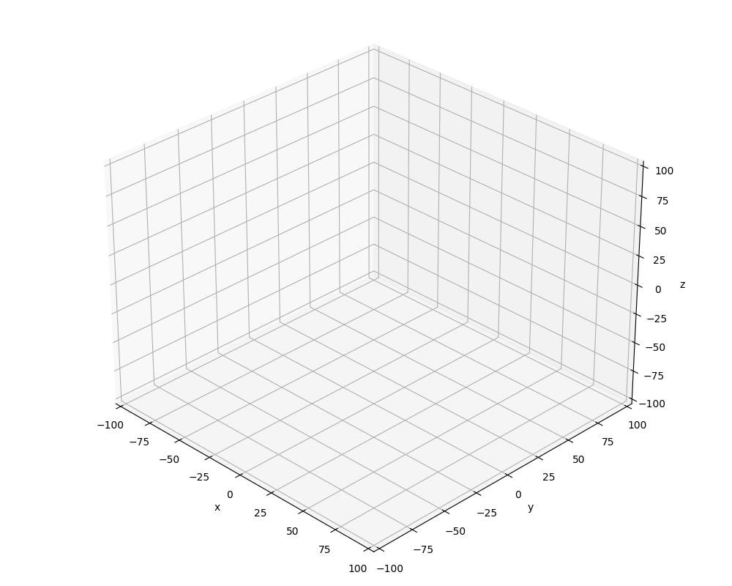
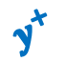


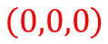
3D Cartesian Coordinates in matplotlib
$$z^{+}$$
$$y^{+}$$
$$z^{+}$$
$$x^{+}$$
$$\left(0,0,0\right)$$
$$y^{+}$$
$$x^{+}$$

Slide 4
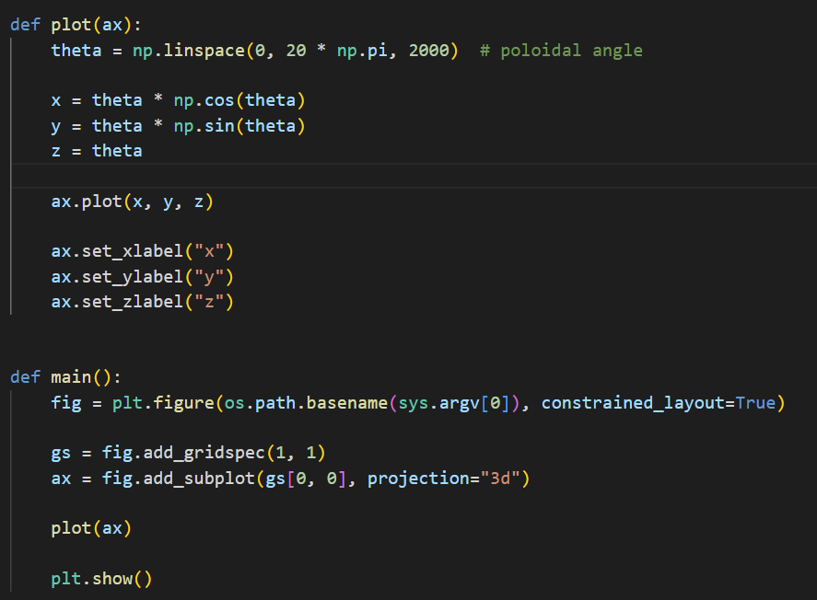
Open plot3d_helix.py
①
②
③
④
⑤

Slide 5
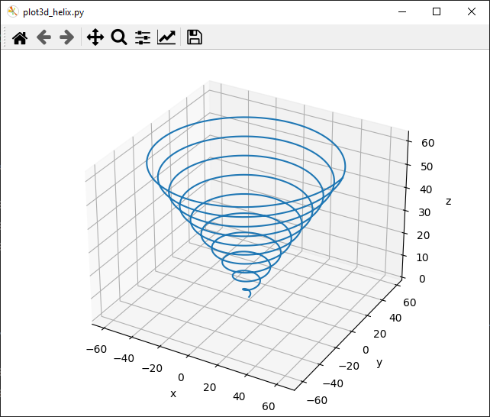
Run plot3d_helix.py
Left click and drag to rotate the plot

Slide 6
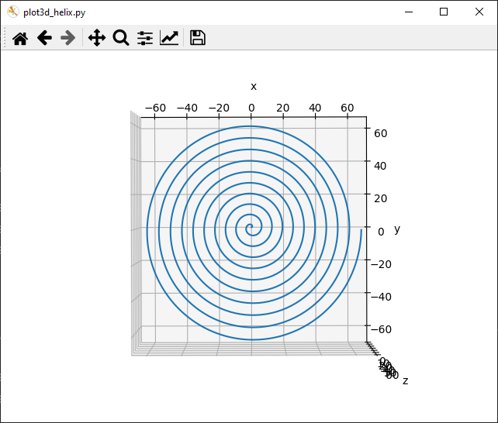
Run plot3d_helix.py

Slide 7
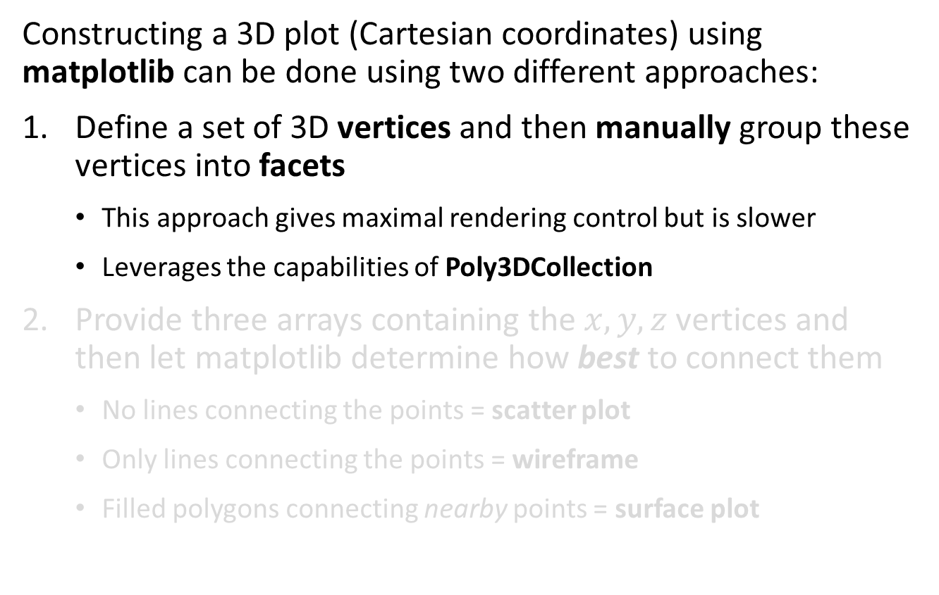
3D Axes in matplotlib
Constructing a 3D plot (Cartesian coordinates) using matplotlib can be done using two different approaches:
Define a set of 3D vertices and then manually group these vertices into facets
This approach gives maximal rendering control but is slower
Leverages the capabilities of Poly3DCollection
Provide three arrays containing the $x, y, z$ vertices and then let matplotlib determine how best to connect them
No lines connecting the points = scatter plot
Only lines connecting the points = wireframe
Filled polygons connecting nearby points = surface plot

Slide 8
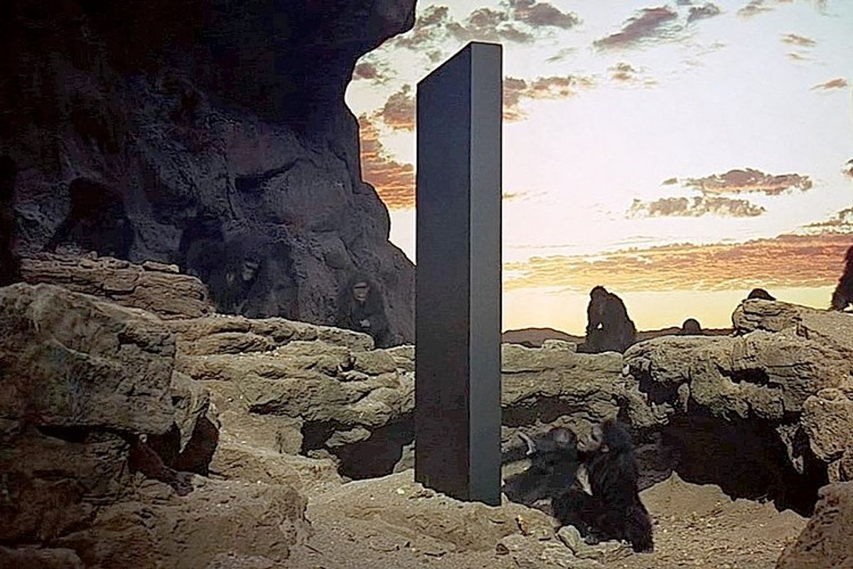
Drawing a Monolith

Slide 9
3D Cartesian Coordinates in matplotlib
$$width$$
$$length$$
$$height$$
$$height$$
$$width$$
$$length$$

Slide 10
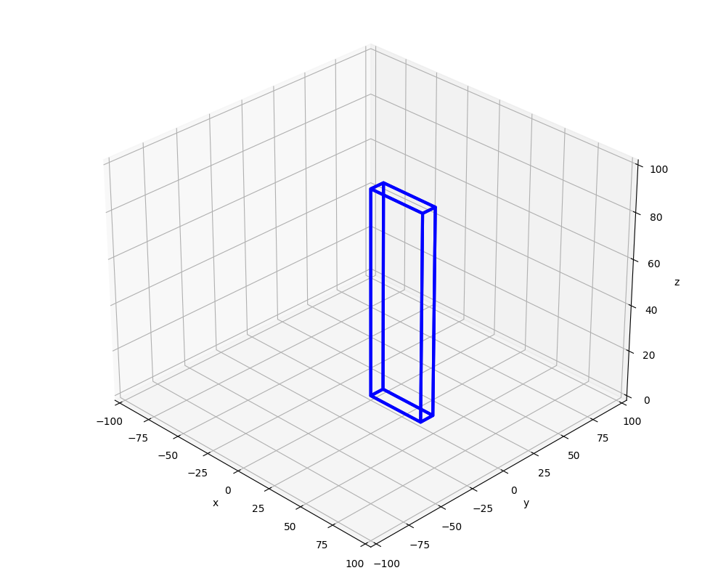
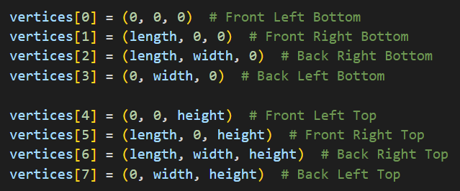
3D Cartesian Coordinates in matplotlib
⑦
④
$$length$$
⑥
⑤
$$height$$
$$length$$
③
$$width$$
⓪
②
①

Slide 11
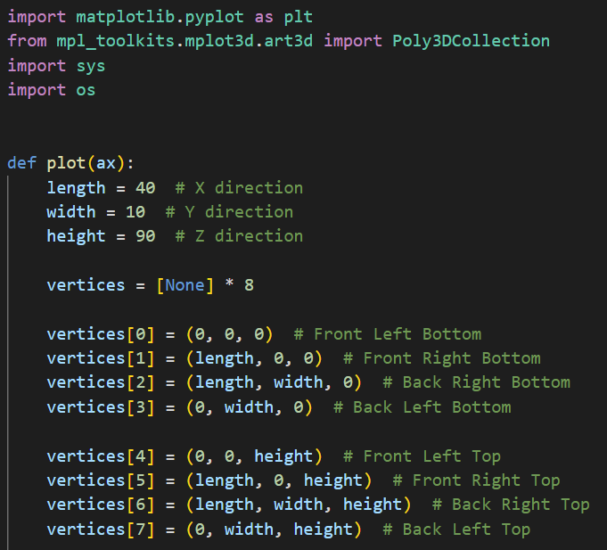
Open plot3d_monolith.py
①
②
③
④
⑤

Slide 12
3D Cartesian Coordinates in matplotlib
①
⑤
②
③
⓪
④

Slide 13
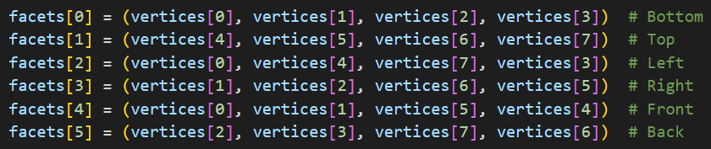
3D Cartesian Coordinates in matplotlib
⑦
④
①
⑥
⑤
⑤
②
③
③
⓪
⓪
②
④
①

Slide 14
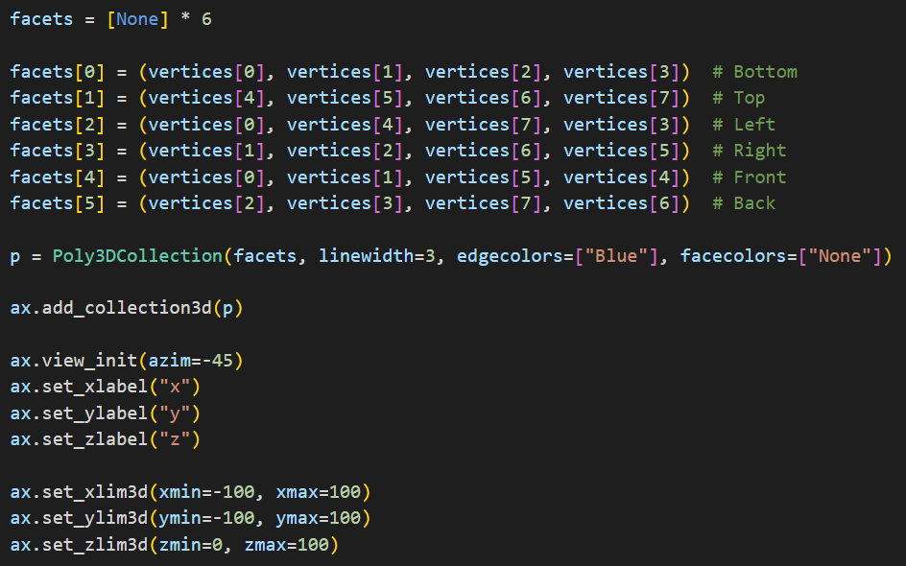
View plot3d_monolith.py
①
②
③
④
⑤
⑥
⑦
⑧

Slide 15
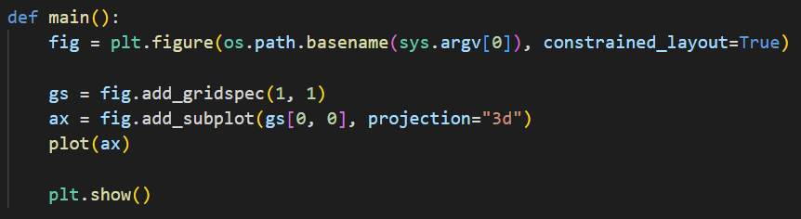
View plot3d_monolith.py
①
②

Slide 16
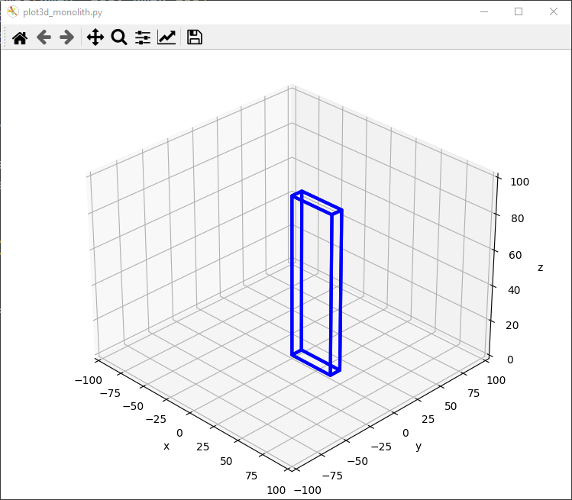
Run plot3d_monolith.py
☺

Slide 17
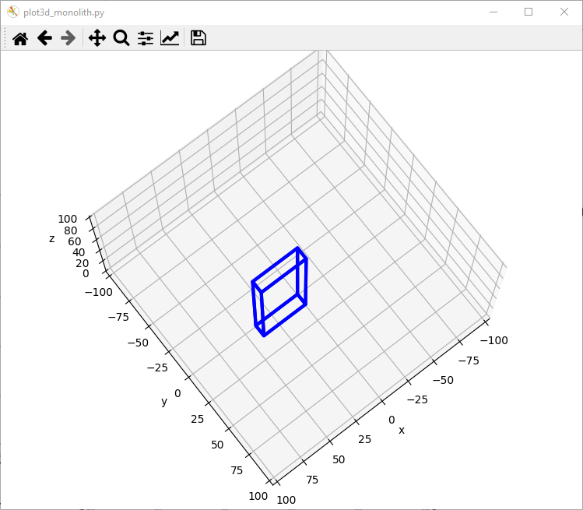
Run plot3d_monolith.py
Left click and drag to rotate the plot

Slide 18
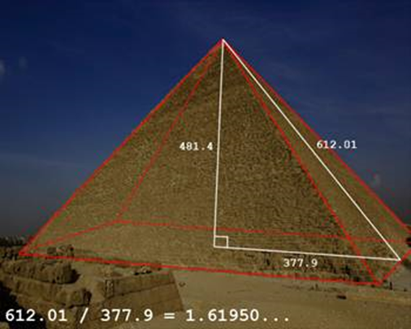
Drawing a Pyramid
Draw a pyramid with $length=width=150$ and $height=length ∗ φ$

Slide 19
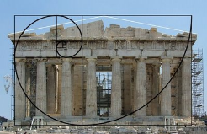

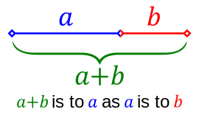
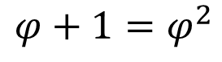
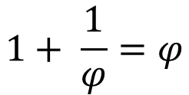
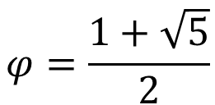
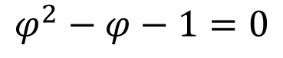
The Golden Ratio
$$1+ \frac{1}{φ}=φ$$
$$φ+1=φ^{2}$$
$$\frac{a+b}{a}=\frac{a}{b}=φ$$
$$φ^{2}−φ−1=0$$
$$1+ \frac{b}{a}=\frac{a}{b}=φ$$
$$φ=\frac{1+\sqrt{5}}{2}$$

Slide 20
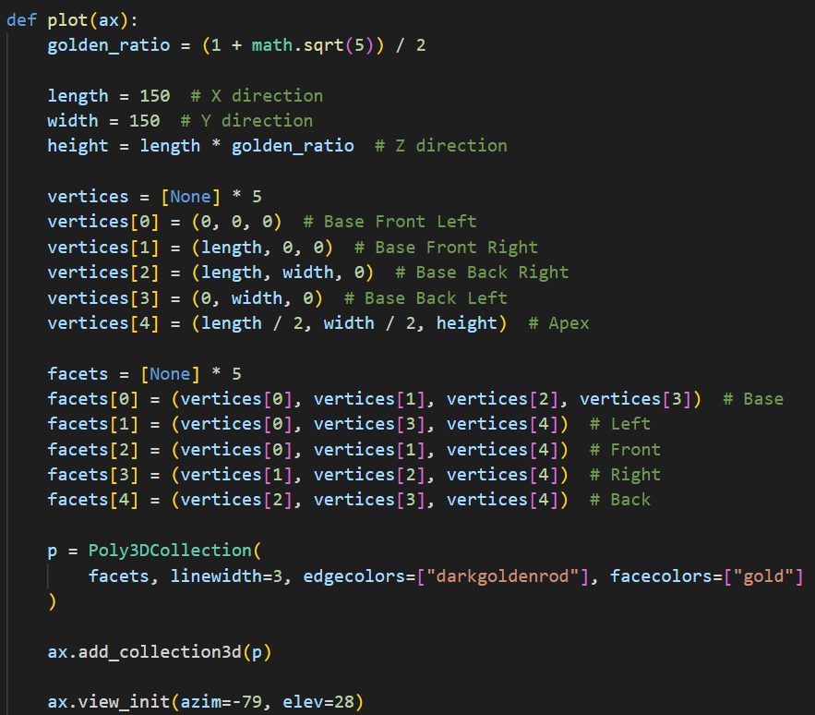
Open plot3d_pyramid.py
①
②
③
④
⑤
⑥
⑦
⑧
⑨
⑩

Slide 21
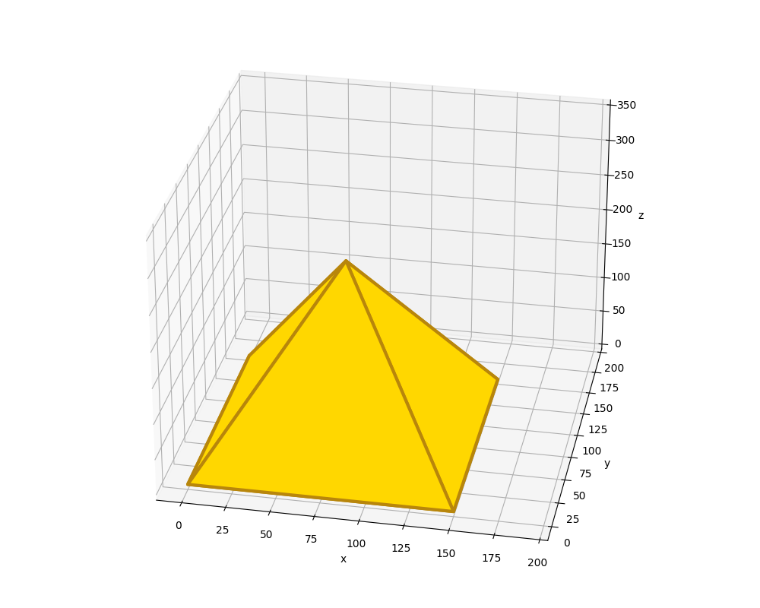
Run plot3d_pyramid.py
☺

Slide 22
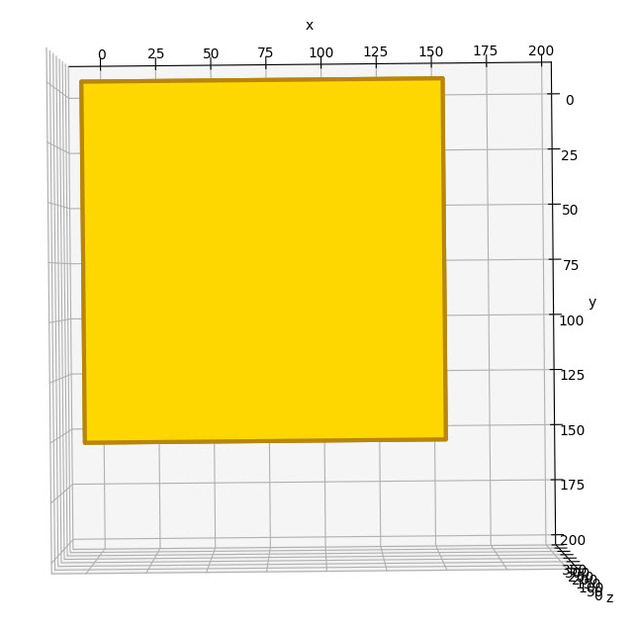
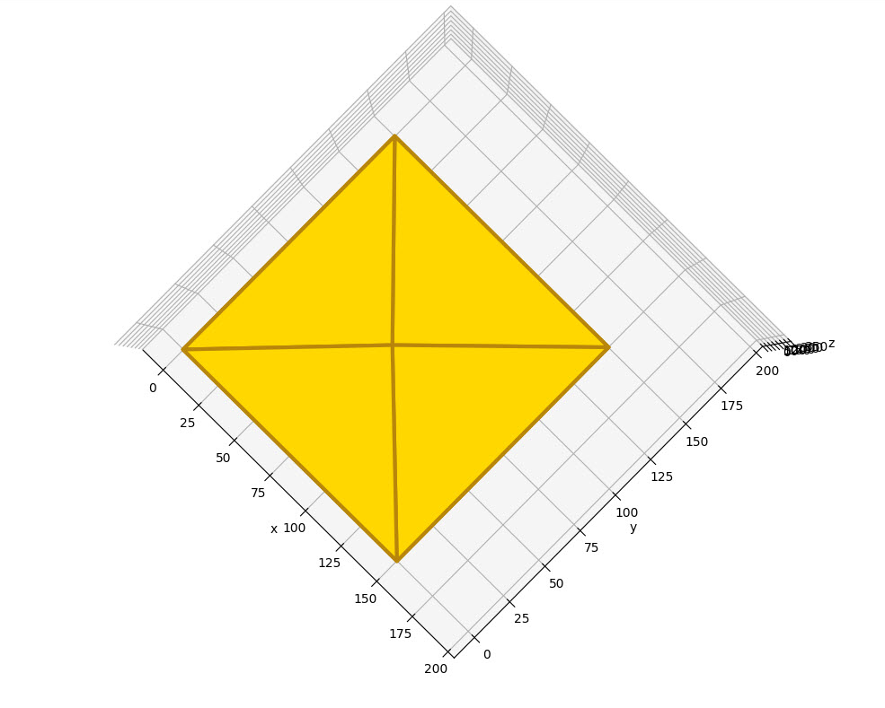
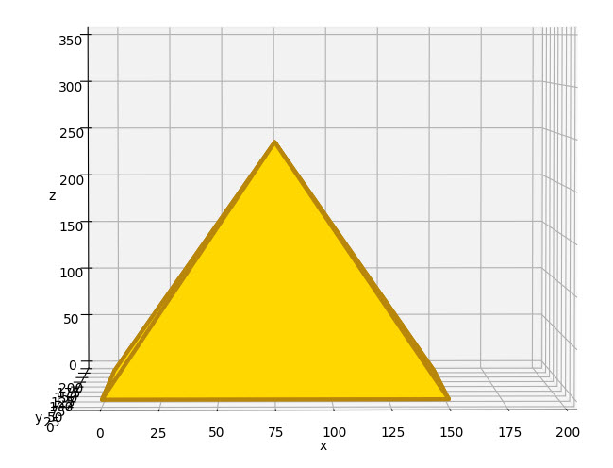
View plot3d_pyramid.py

Slide 23
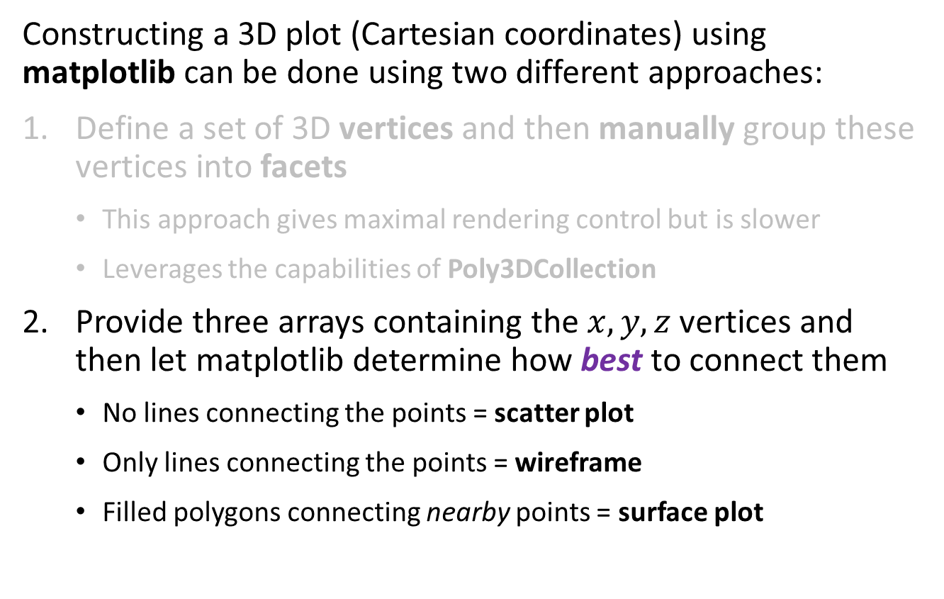
3D Axes in matplotlib
Constructing a 3D plot (Cartesian coordinates) using matplotlib can be done using two different approaches:
Define a set of 3D vertices and then manually group these vertices into facets
This approach gives maximal rendering control but is slower
Leverages the capabilities of Poly3DCollection
Provide three arrays containing the $x, y, z$ vertices and then let matplotlib determine how best to connect them
No lines connecting the points = scatter plot
Only lines connecting the points = wireframe
Filled polygons connecting nearby points = surface plot

Slide 24
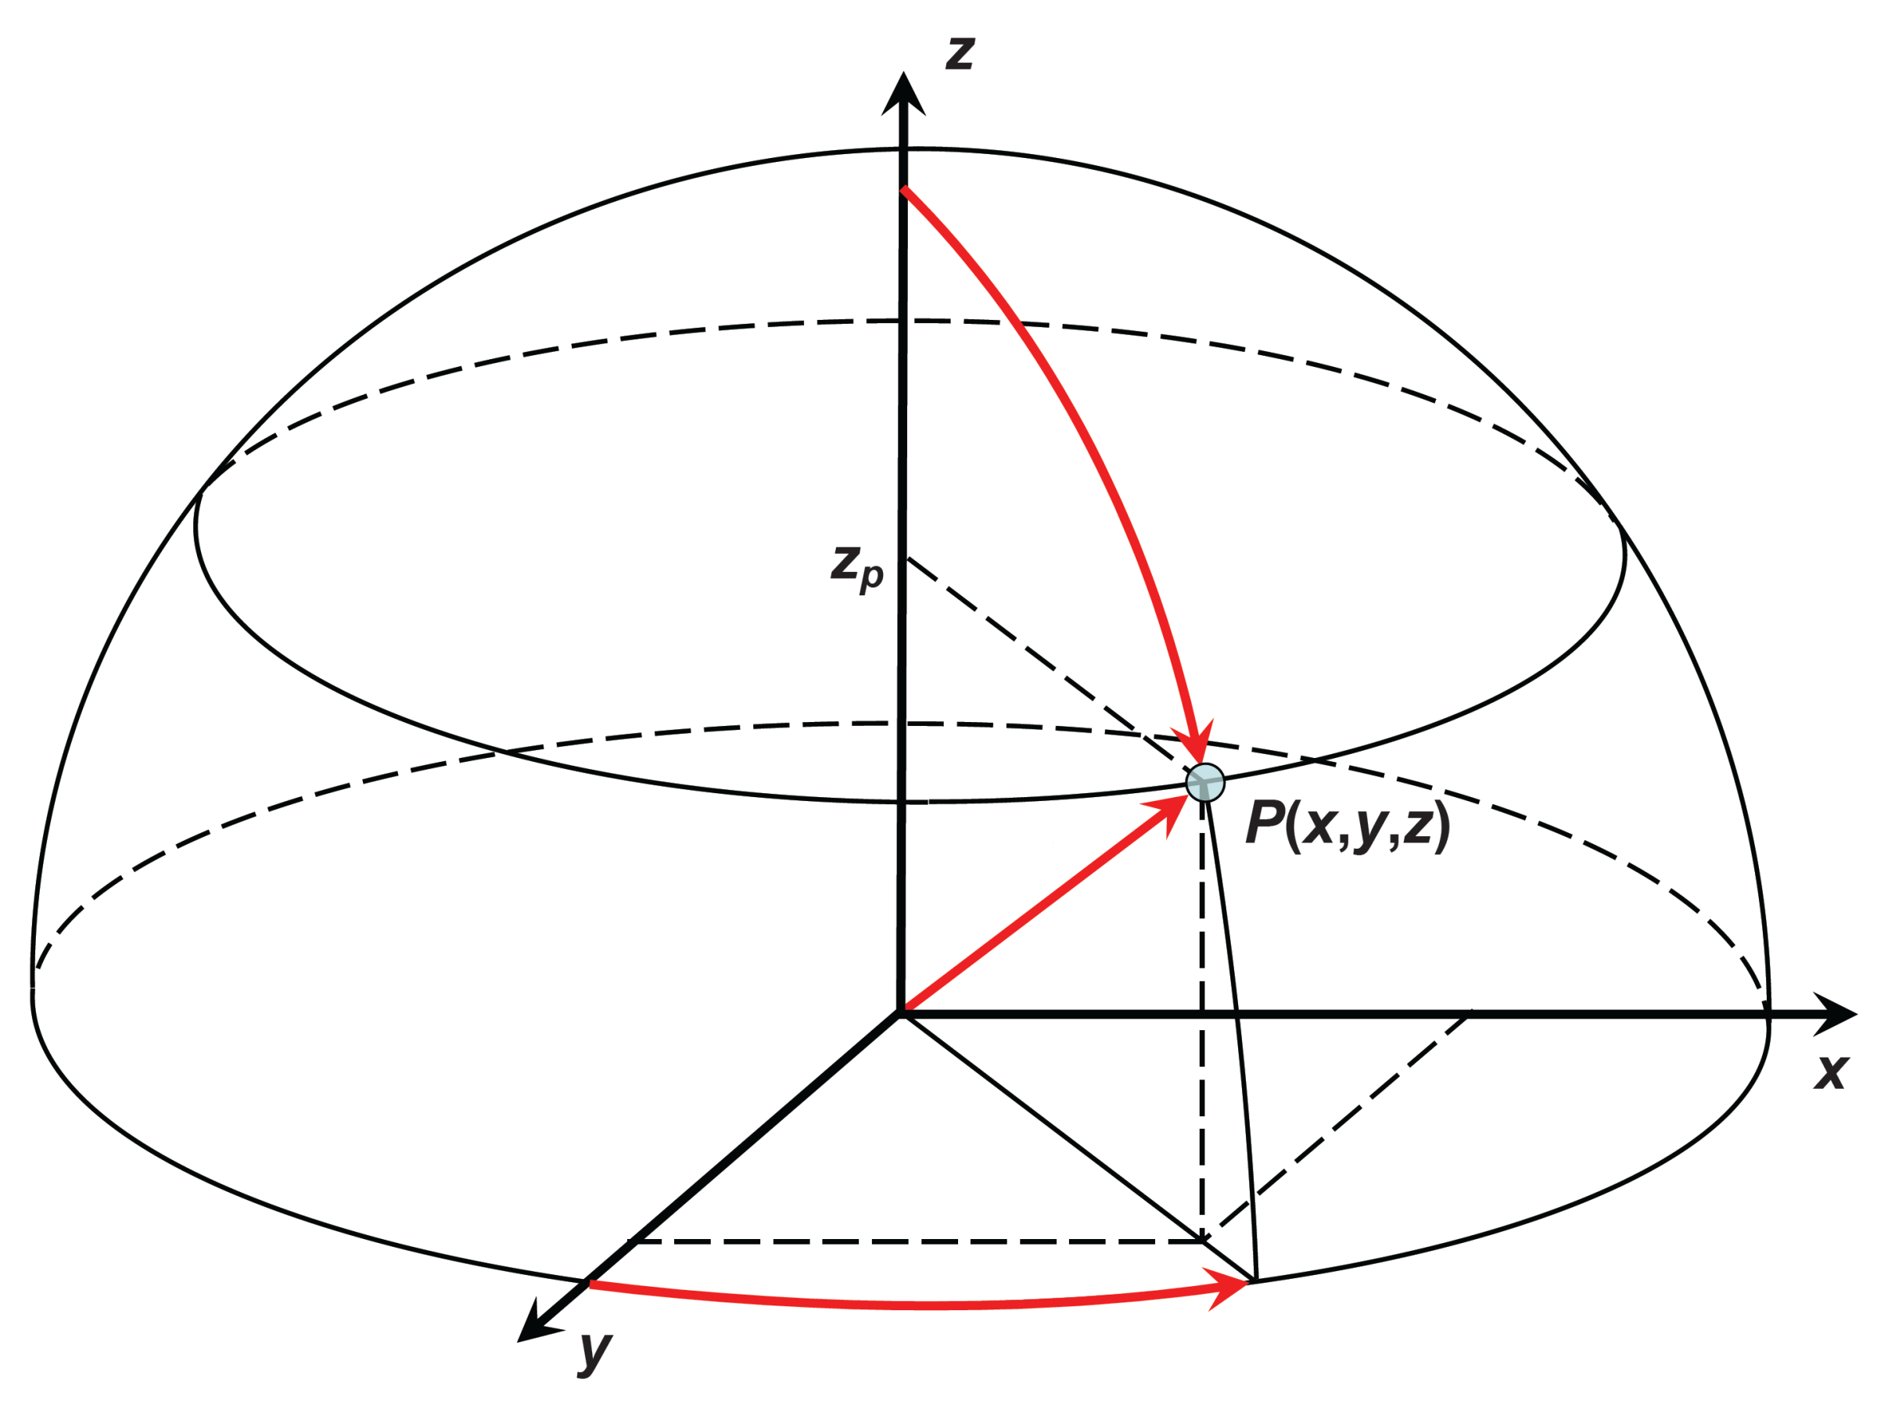

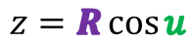
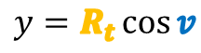
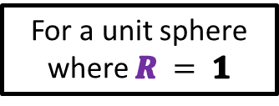

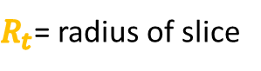
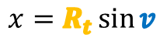
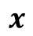
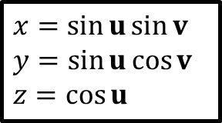

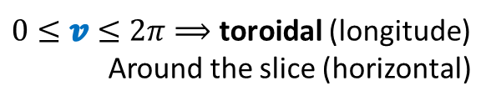
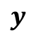
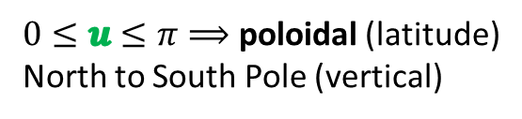
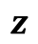

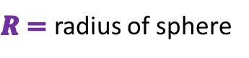


Poloidal and Toroidal Angles
$0≤u≤π⟹$ poloidal (latitude)
North to South Pole (vertical)
$0≤v≤2π⟹$ toroidal (longitude)
Around the slice (horizontal)
$R=$ radius of sphere
$R_{t}$= radius of slice
$$z=R\cos{u}$$
$$x=R_{t}\sin{v}$$
$$R_{t}=R\sin{u}$$
$$y=R_{t}\cos{v}$$
$$z$$
$$x=\sin{u}\sin{v}$$
$$y=\sin{u}\cos{v}$$
$$z=\cos{u}$$
$$R_{t}$$
$$u$$
$$R$$
$$R$$
$$x$$
$$v$$
$$R_{t}$$
For a unit sphere where $R = 1$
$$y$$

Slide 25
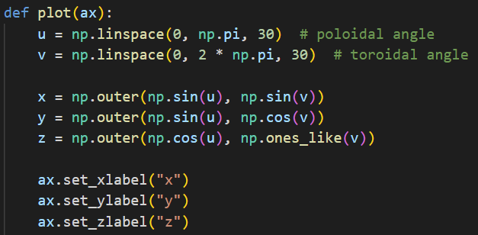
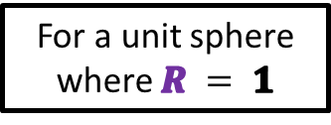
Matrices and Outer Product
$$u=(u_{1},u_{2},⋯,u_{m})$$
$$v=(v_{1},v_{2},⋯,v_{n})$$
$$x=sin{u}⨂\sin{v}$$
$$y=sin{u}⨂\cos{v}$$
$$z=\cos{u}⨂1$$
$$x=\sin{u}\sin{v}$$
$$y=\sin{u}\cos{v}$$
$$z=\cos{u}$$
$$a⨂b=\left[\begin{matrix}\begin{matrix}a_{1}b_{1} & a_{1}b_{2} \\ a_{2}b_{1} & a_{2}b_{2}\end{matrix} & ⋯ & \begin{matrix}ab_{n} \\ a_{2}b_{n}\end{matrix} \\ ⋮ & ⋱ & ⋮ \\ \begin{matrix}a_{m}b_{1} & a_{m}b_{2}\end{matrix} & ⋯ & a_{m}b_{n}\end{matrix}\right]$$
For a unit sphere where $R = 1$
Outer Product of Two Vectors

Slide 26
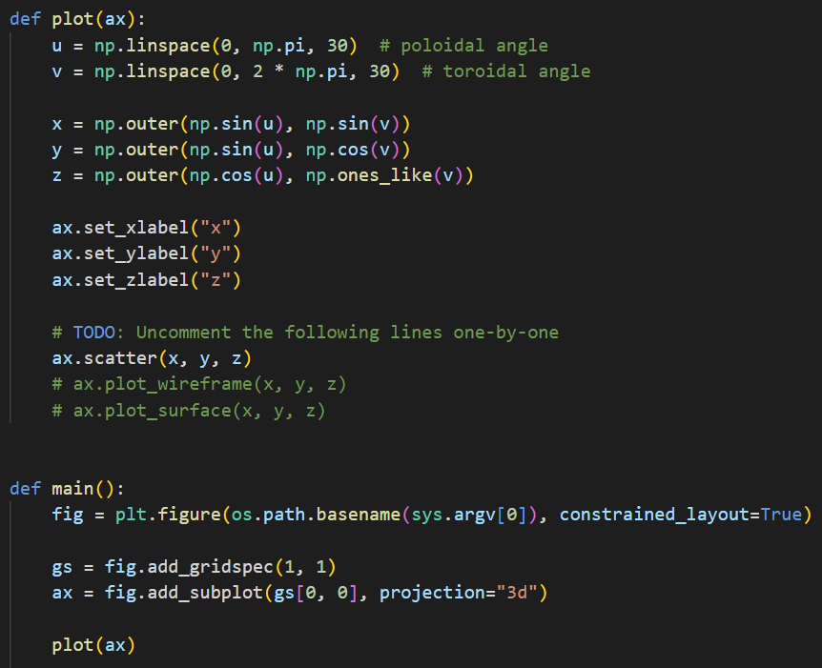
Open plot3d_sphere.py
④
⑤
⑥
⑦
⑧
⑨
①
②
③

Slide 27
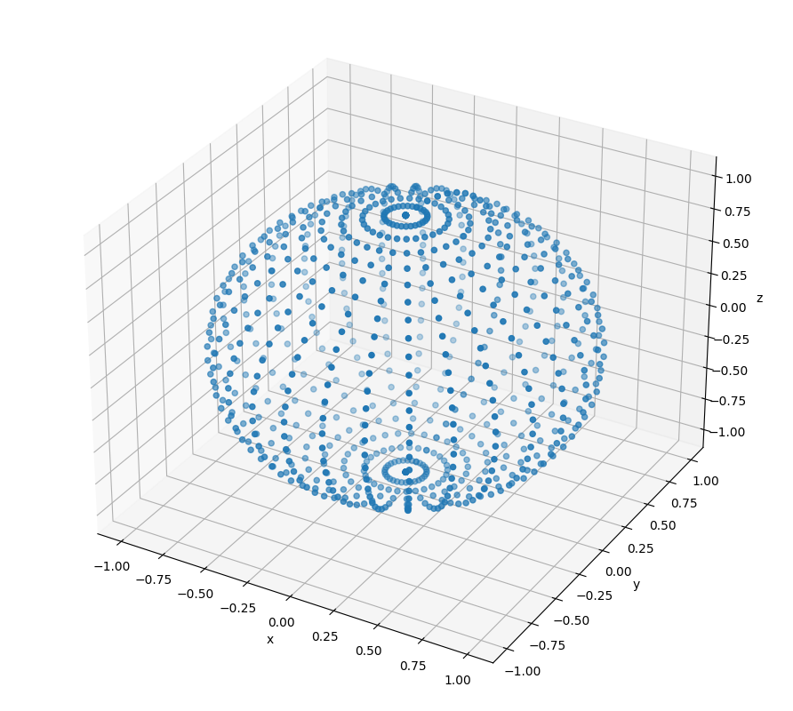
Run plot3d_sphere.py

Slide 28
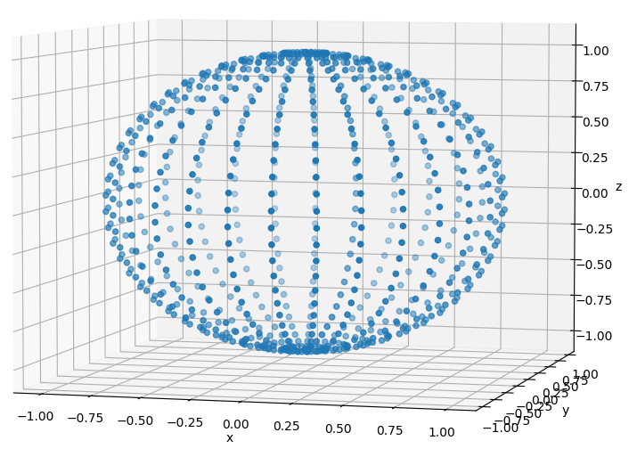
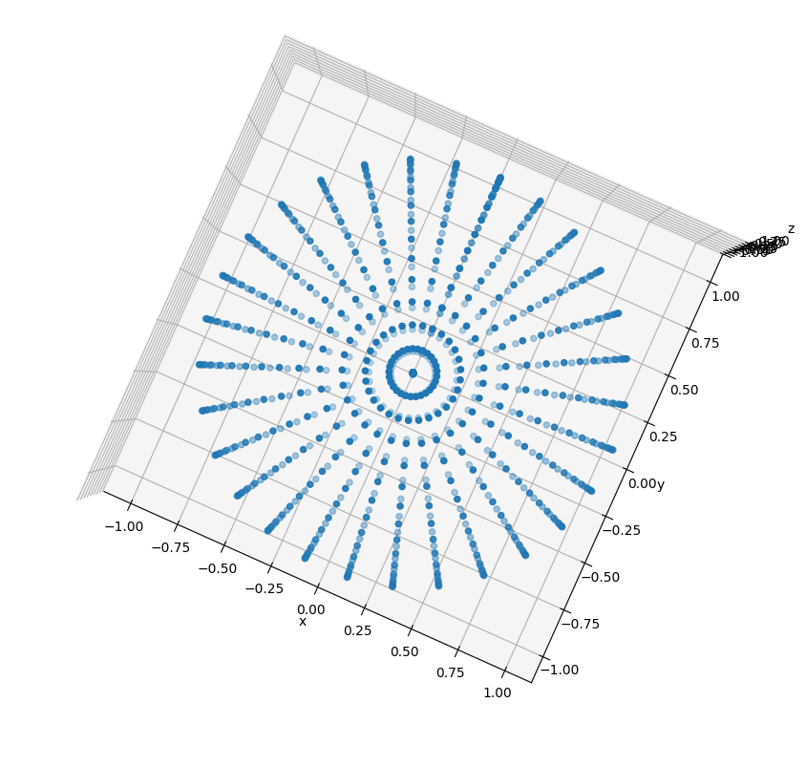
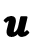
Run plot3d_sphere.py
$0≤v≤2π⟹$ toroidal (longitude)
Around the slice (horizontal)
$$u$$
$$R$$
$R_{t}$= radius of slice
$$v$$
$$R_{t}$$
$0≤u≤π⟹$ poloidal (latitude)
North to South Pole (vertical)

Slide 29
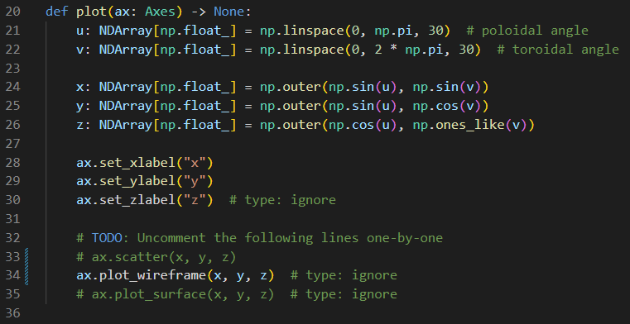
Edit plot3d_sphere.py
Comment out line 33
Uncomment line 34

Slide 30

Run plot3d_sphere.py

Slide 31

View plot3d_sphere.py
Top-Down
View

Slide 32



What is a vector?
$a_{x} a_{y} a_{z}$ are the components of
vector$\overset{⃑}{a}$
$$a_{x}={P2}_{x}−{P1}_{x}$$
$$a_{y}={P2}_{y}−{P1}_{y}$$
$$a_{z}={P2}_{z}−{P1}_{z}$$

Slide 33

What is a vector?
How do we avoid drawing the facets which are on the back of the sphere?
$$\overset{⃑}{a}$$
⓿
❶
$$\overset{⃑}{b}$$
❷

Slide 34



Vector Cross Product
The cross product of two vectors is another vector which is perpendicular to both vectors A and B

Slide 35




Every Facet has a Surface Normal Vector

Slide 36


Vector Dot Product
The dot product gives the angle between two vectors

Slide 37




Back Face Culling and Facet Shading
$$\vec{n}$$
Camera / Eye Location
$$θ$$

Slide 38

Edit plot3d_sphere.py
Comment out line 34
Uncomment line 35

Slide 39

Run plot3d_sphere.py
Left click and drag to rotate the plot

Slide 40

Run plot3d_sphere.py

Slide 41


Modelling a Torus
Your scientist would like to begin modelling the electromagnetic field around a toroidal coil carrying AC current
The first step will be defining and drawing a 3D torus using a modified version of the spherical coordinate system
The red arrow points in the poloidal direction and the blue arrow points in the toroidal direction
A sphere and a torus are not homeomorphic: unlike a sphere, a torus needs two radii to fully describe it

Slide 42






Modelling a Torus
Note: $0≤u≤2π$
$$u$$
$$(z)$$
$$R_{p}$$
$$R_{t}$$
$$x=\left[R_{t}+R_{p}\sin{u}\right]\cos{v}$$
$$y=\left[R_{t}+R_{p}\sin{u}\right]\sin{v}$$
$$z=R_{p}\cos{u}$$

Slide 43

Modelling a Torus
$$(x,y)$$
$$v$$
$$R_{t}$$
$$R_{p}$$
$$x=\left[R_{t}+R_{p}\sin{u}\right]\cos{v}$$
$$y=\left[R_{t}+R_{p}\sin{u}\right]\sin{v}$$
$$z=R_{p}\cos{u}$$

Slide 44

Open plot3d_torus.py
①
②
③
④
⑤
⑥
⑦

Slide 45

Run plot3d_torus.py

Slide 46

Edit plot3d_torus.py
Comment out line 45
Uncomment line 47

Slide 47

Run plot3d_torus.py

Slide 48


Open plot3d_surface.py
①
⑥
$$f\left(x,y\right)=\sin\left(\sqrt{x^{2}+y^{2}}\right)$$
②
③
④
NumPy Meshgrid From Zero To Hero
⑤
⑦
⑧
⑨
⑩

Slide 49



Run plot3d_surface.py
$$f\left(x,y\right)=\sin\left(\sqrt{x^{2}+y^{2}}\right)$$

Slide 50


View plot3d_surface.py

Slide 51
Session 15 – Now You Know…
How to draw 3D images with matplotlib
How to create vertices and facets to manually build wireframe and surface plots
How to create vectors of 3D coordinates using radial angles and outer products and then letting matplotlib automatically connect nearby vertices, so it can render wireframes and surface plots
Vector algebra, including inner (dot) product and cross product, can be used to enable back-face culling and facet shading
Two shapes that are not homeomorphic may require additions to the parametric equations (inserting another radius or tracking another angular measure) such as drawing a torus vs. a sphere

Slide 52


Task 15-01
Create a Python file called plot3d_cylinder.py that uses matplotlib to draw a wireframe cylinder with a unit radius centered at $(0, 0, 0)$
The cylinder should be aligned along the z-axis
Upload your solution to the BNL QIS101 SharePoint site

Slide 53


Task 15-02
Create a Python file called plot3d_complex_sine.py that uses matplotlib to draw the surface in $ℂ$ given by $f\left(z\right)=\left|\sin\left(z\right)\right|$ over the region $\left(±2.5±i\right)$
Upload your solution to the BNL QIS101 SharePoint site

